Slide 1




Weather Image Recognition
Deep Learning
Prepared by:
Amgad Shalaby
Ashraf Mahmoud
Hamdy Hamada zaied
Nada Ibrahem
Under the Supervision of:
Eng. Abdelrahman A. Eid

Slide 2
Table of contents
01
02
03
04
Introduction
Approach
Results
Deployment

Slide 3


01
Introduction

Slide 4

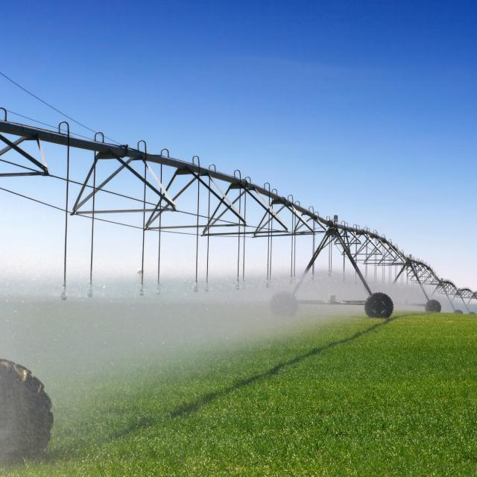
Importance of Knowing Weather Conditions
In various industries, the ability to accurately assess current and historical weather conditions is crucial for effective decision-making and operational optimization.
For instance, farmers might look at the current weather to decide if the sprinklers should be turned on or off. Ski resort operators might choose to enable snowmaking machines based on varying weather conditions across the mountain. Construction workers might plan out the supplies and rain gear they’ll need for a remote job site. Racing games like Formula One (F1) might deiced to change the tires of the car from the ordinary one to the full wet tires which used in heavy raining.

Slide 5


Traditional Way
Currently, making such decisions can require manually looking at video feeds from remote cameras, relying on weather forecasts, or simply looking out the window.

Slide 6
AI Way
Using deep learning (DL) offers the potential to automate this by providing a digital eye.
More specifically, if an image recognition DL model could be built to identify conditions by simply looking at images of the weather, it could be deployed in scenarios like those described above.
For example, a camera feed on a farm could be processed by an DL model deployed on an IoT device at the edge (e.g., on a smart camera). That model can then be used to automatically determine the current weather conditions and enable or disable sprinkler valves accordingly.

Slide 7
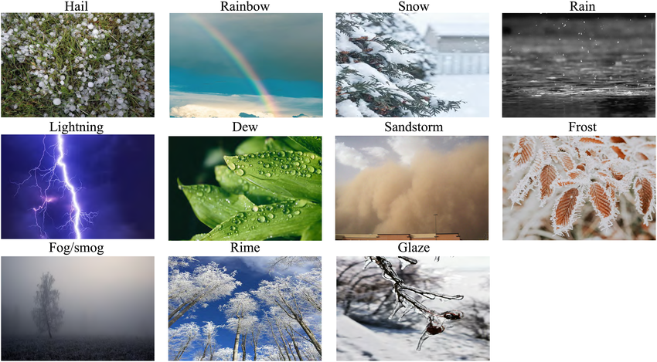
Taking Action!!
To demonstrate this use case, we built a model trained to classify 11 different types of weather. We used 6862 images from the Multi-class Weather Dataset for Image Classification: dew, fog/smog, frost, glaze, hail, lightning , rain, rainbow, rime, sandstorm and snow.

Slide 8

02
Approach

Slide 9
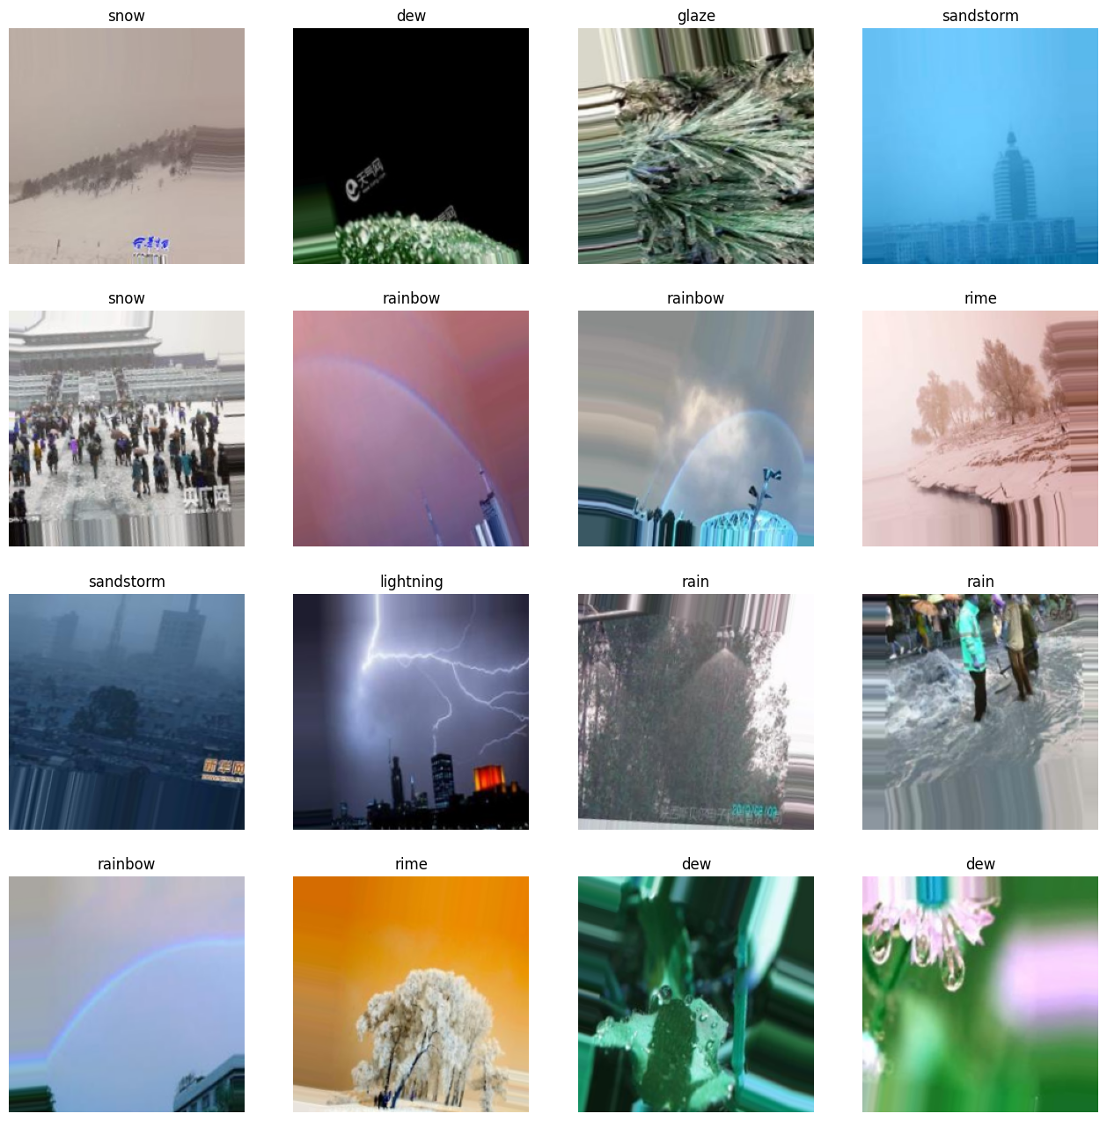
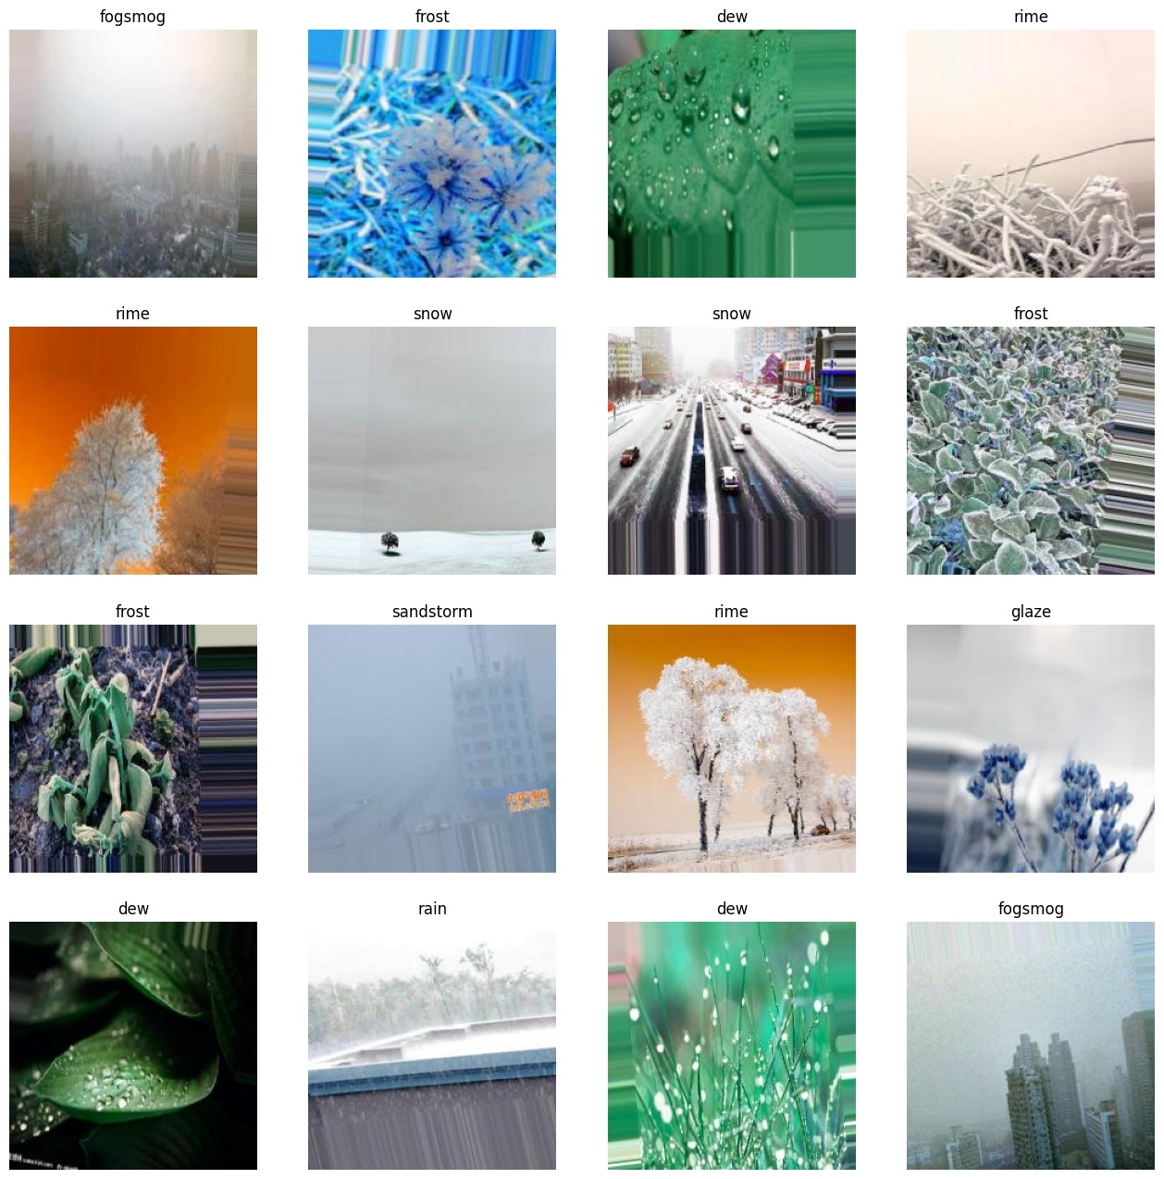
Sample of Data

Slide 10
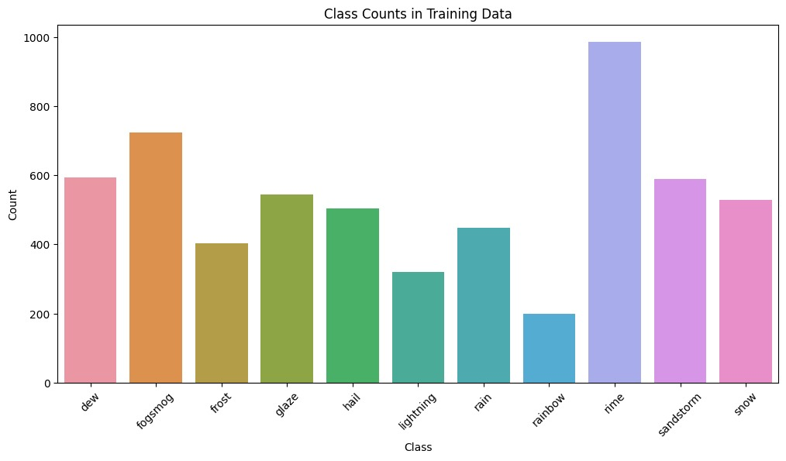
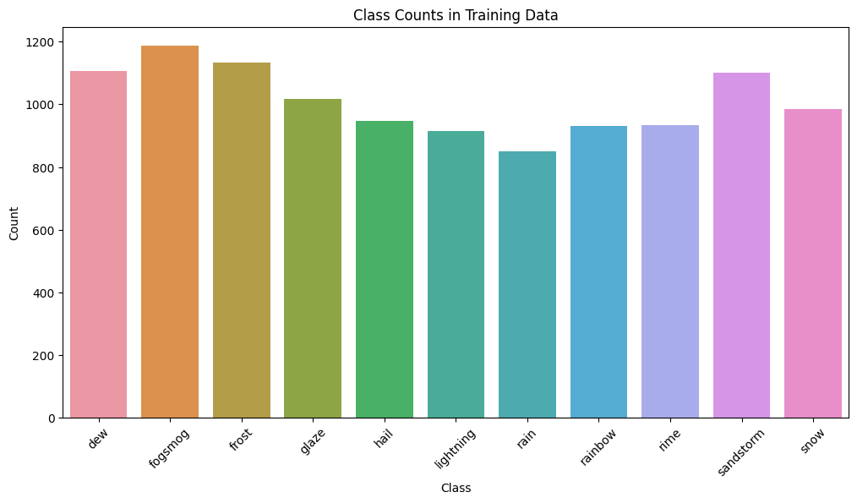
Data Preprocessing
Imbalanced Data
Data Augmentaion
The data is now approx. balanced

Slide 11
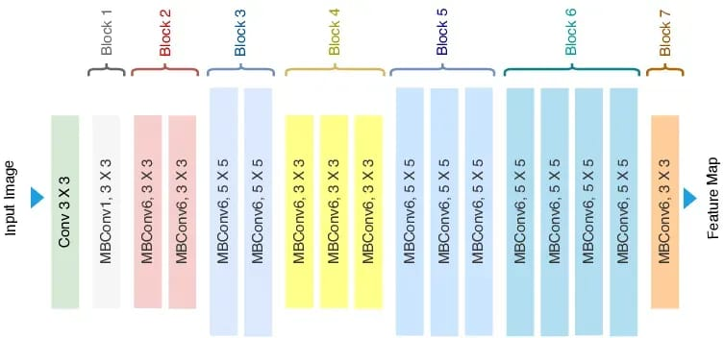
Model Building
EfficientNet-B0 Architecture

Slide 12
Model Summary
Utilizes EfficientNet-B0 pre-trained model for feature extraction in image classification tasks.
Sequentially stacks layers including global average pooling and multiple dense layers with ReLU and LeakyReLU activations.
Incorporates dropout layers for regularization to prevent overfitting.
Final dense layer employs softmax activation for multi-class classification.
Provides flexibility for model compilation, training, and potential fine-tuning of pre-trained weights.
Offers a versatile framework for building and customizing CNNs tailored to specific image classification needs.

Slide 13
03
Results

Slide 14
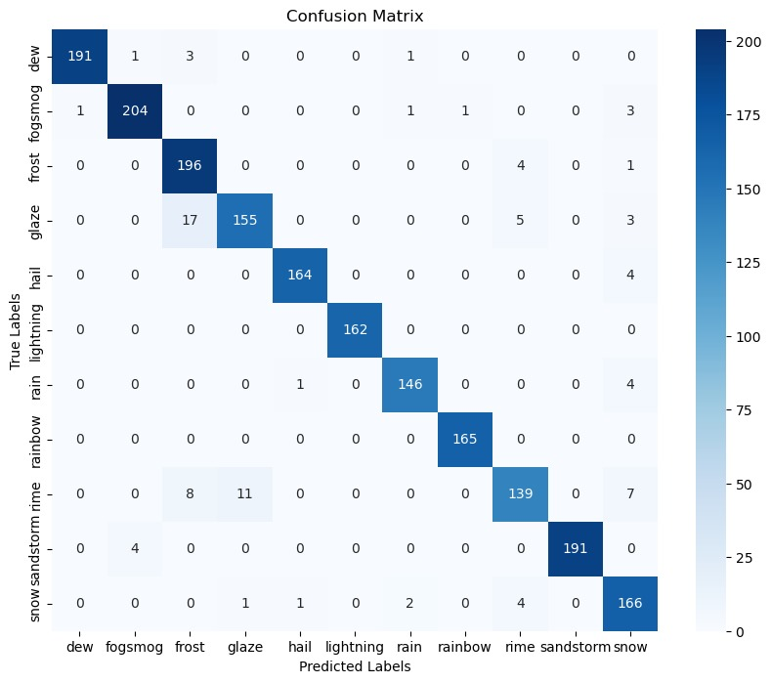
Confusion Matrix

Slide 15
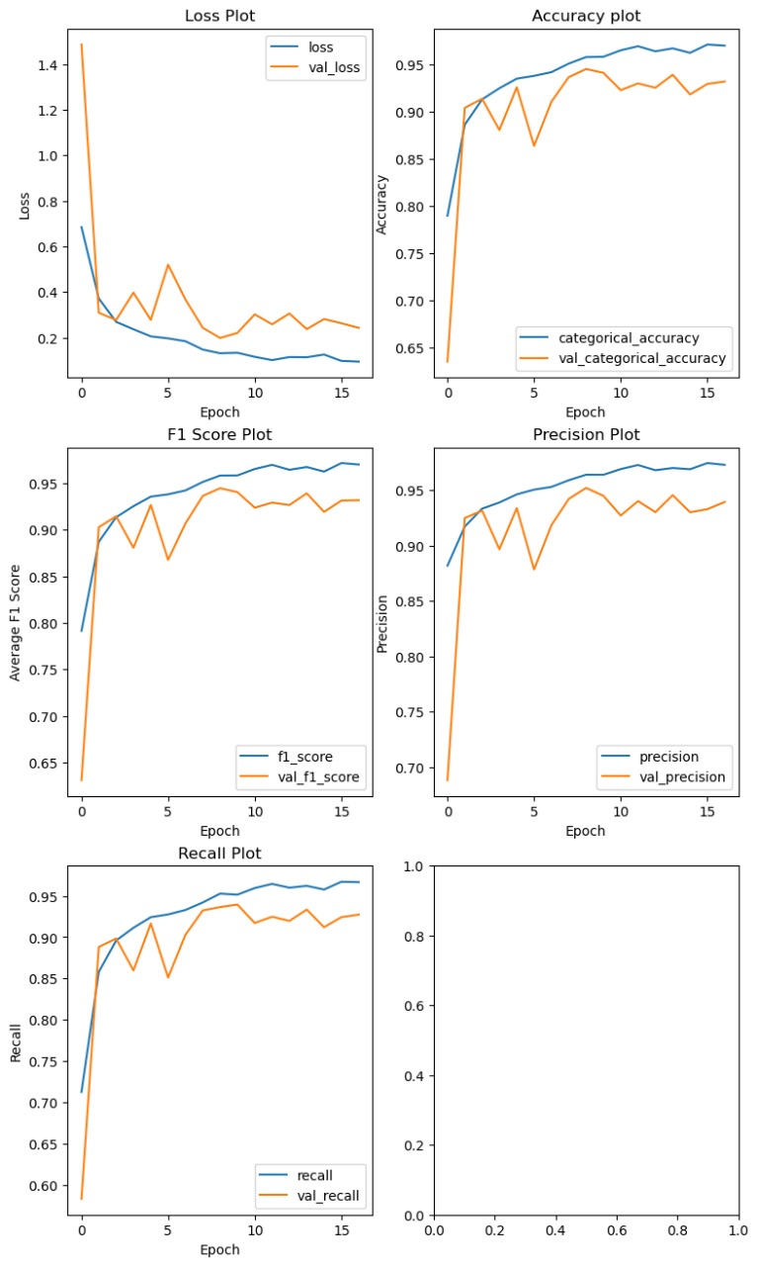
Results Curves
We had used Accuracy(Precision, recall and F1 score) to measure how will our model is
As we can see from the graphs there is no overfitting or underfitting.

Slide 16
04
Deployment

Slide 17
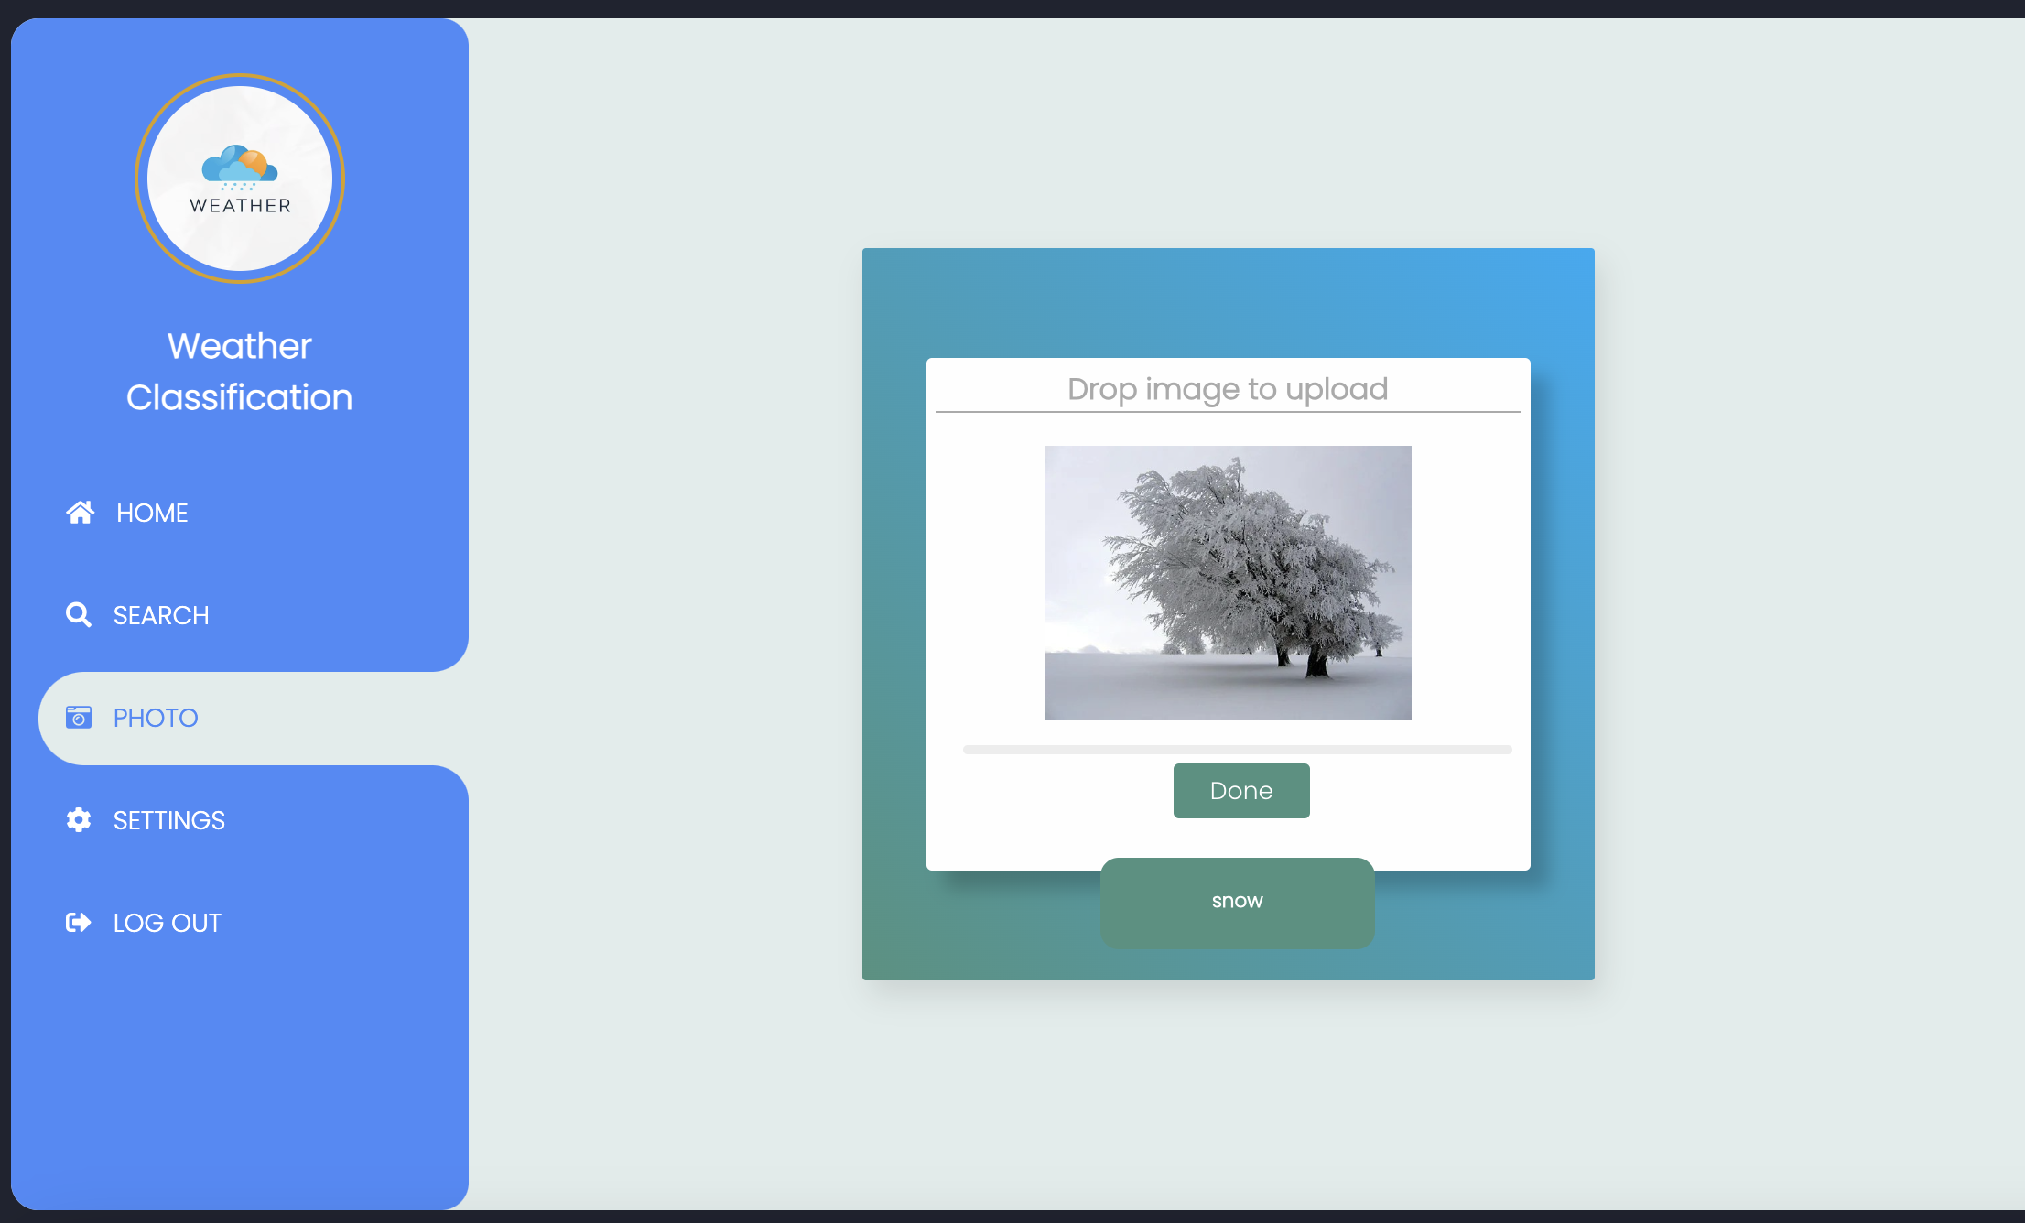
Weather Classification Web
Deploy our model using flask

Slide 18
Thanks!

